Slide 1


Siew Keong, Choo
Senior Validation Engineer

Slide 2
My Working Experiences
Sr. Validation Engineer
Manual testing
Test management (requirement, design, execution, analysis)
Test planning (resource and schedule)
Test document
Frontend testing
Backend testing
UI automation
API automation
Customer support
Team supervision
Collaboration among projects and teams
Validation Engineer
Hardware testing
Test data automation
Test execution and improvement
Automation Engineer
Testing tool and environment
UI manual testing
UI automated testing
Graduation

Slide 3
My Current Job
Frontend Testing
HOST
Request
DEVICE
Method, Data
PROTOCOL
Response
Status, Data
Backend Testing

Slide 4
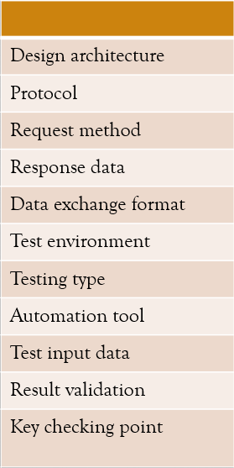
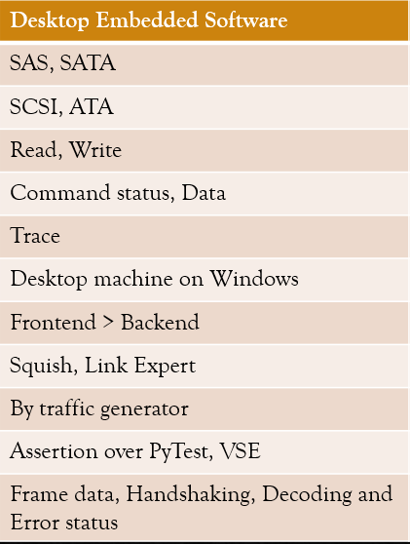
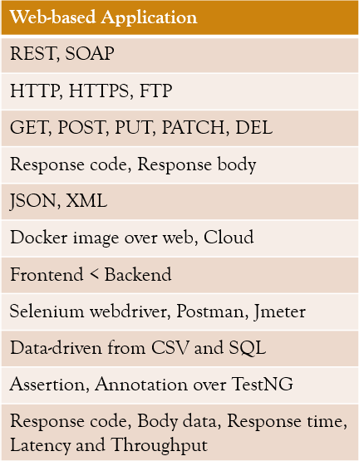
Knowledge Migration

Slide 5
Testing Flows
Understand, Plan, Design, Setup
Manual testing
Smoke testing, User acceptance testing, Regression testing, Security testing
Agile development
Software / Application under test
T.E.S.T = Techniques + Executions + Strategics + Tools
Execution
Analysis
Release
Report
Research, Learn, Develop, Expand
Automated testing
Unit testing, Integration testing, Performance testing, Usability testing

Slide 6

My Roles in The Current Job
To Team Manager
(Status report and
Future task planning)
To Project Manager
(Release update and weekly bug review)
To Development Team
(Technical discussion and Automation maintenance)
To Myself
(Test qualify improvement and Automation development)
To Support Team
(Customer’s issue inspection and Workaround)
To Test Engineer
(Guideline for testing task and supervision on skillset growth)

Slide 7

Thank You
Higher Learning.
Higher Earning.

